Slide 1
Chapter 14:
Distributed Operating Systems

Slide 2
Chapter 14: Distributed Operating Systems
Motivation
Types of Distributed Operating Systems
Network Structure
Network Topology
Communication Structure
Communication Protocols
Robustness
Design Issues
An Example: Networking

Slide 3
Chapter Objectives
To provide a high-level overview of distributed systems and the networks that interconnect them
To discuss the general structure of distributed operating systems

Slide 4
Motivation
Distributed system is collection of loosely coupled processors interconnected by a communications network
Processors variously called nodes, computers, machines, hosts
  Site is location of the processor
Reasons for distributed systems
  Resource sharing
    sharing and printing files at remote sites
    processing information in a distributed database
    using remote specialized hardware devices
  Computation speedup – load sharing
  Reliability – detect and recover from site failure, function transfer, reintegrate failed site
  Communication – message passing

Slide 5
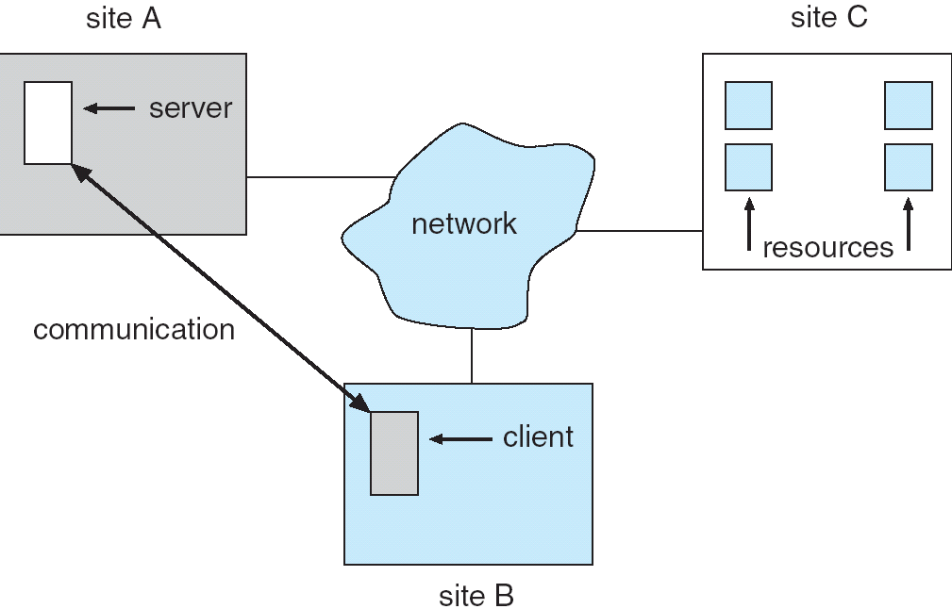
A Distributed System

Slide 6
Types of Distributed Operating Systems
Network Operating Systems
Distributed Operating Systems

Slide 7
Network-Operating Systems
Users are aware of multiplicity of machines. Access to resources of various machines is done explicitly by:
  Remote logging into the appropriate remote machine (telnet, ssh)
  Remote Desktop (Microsoft Windows)
  Transferring data from remote machines to local machines, via the File Transfer Protocol (FTP) mechanism

Slide 8
Distributed-Operating Systems
Users not aware of multiplicity of machines
  Access to remote resources similar to access to local resources
Data Migration – transfer data by transferring entire file, or transferring only those portions of the file necessary for the immediate task
Computation Migration – transfer the computation, rather than the data, across the system

Slide 9
Distributed-Operating Systems (Cont.)
Process Migration – execute an entire process, or parts of it, at different sites
  Load balancing – distribute processes across network to even the workload
  Computation speedup – subprocesses can run concurrently on different sites
  Hardware preference – process execution may require specialized processor
  Software preference – required software may be available at only a particular site
  Data access – run process remotely, rather than transfer all data locally

Slide 10
Network Structure
Local-Area Network (LAN) – designed to cover small geographical area.
  Multiaccess bus, ring, or star network
  Speed ≈ 10 – 100 megabits/second
  Broadcast is fast and cheap
  Nodes:
    usually workstations and/or personal computers
    a few (usually one or two) mainframes

Slide 11
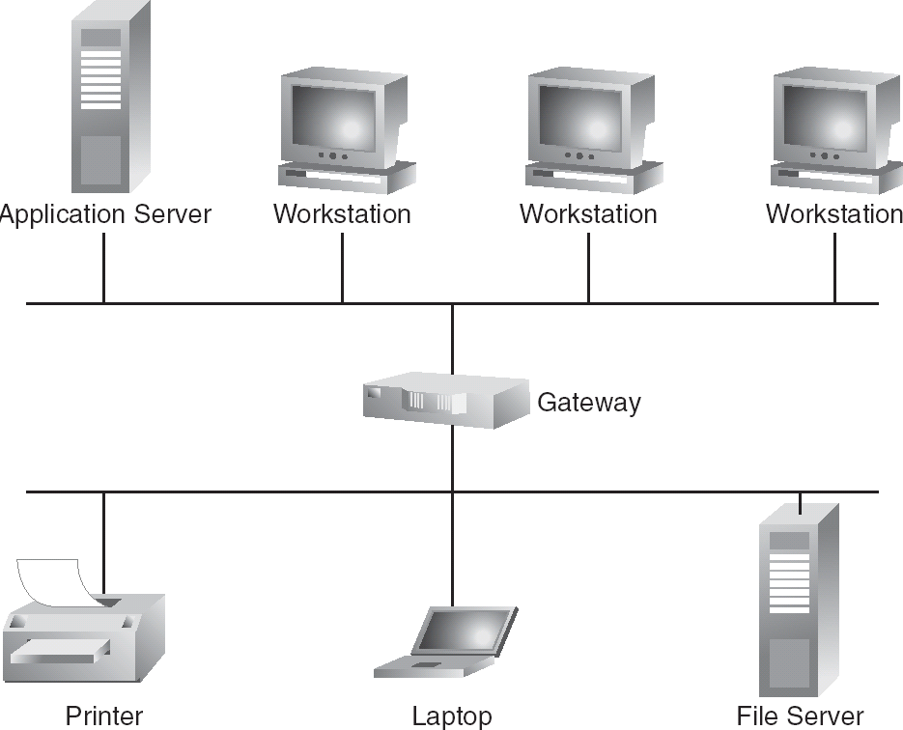
Depiction of typical LAN

Slide 12
Network Types (Cont.)
Wide-Area Network (WAN) – links geographically separated sites
  Point-to-point connections over long-haul lines (often leased from a phone company)
  Speed ≈ 1.544 – 45 megbits/second
  Broadcast usually requires multiple messages
  Nodes:
    usually a high percentage of mainframes

Slide 13
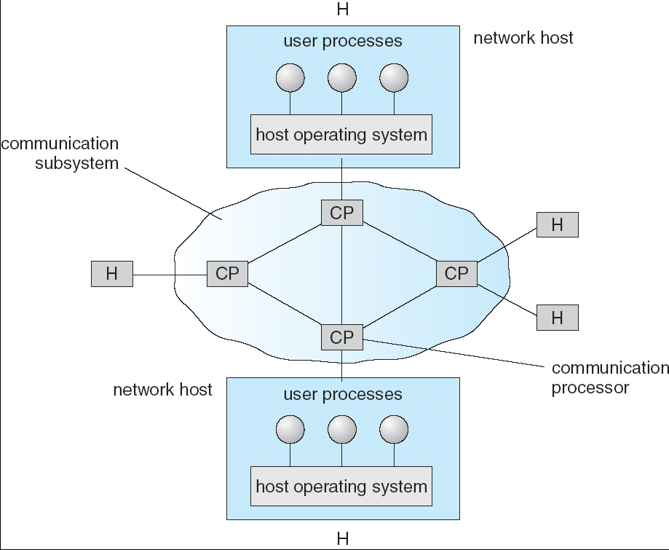
Communication Processors in a Wide-Area Network

Slide 14
Network Topology
Sites in the system can be physically connected in a variety of ways; they are compared with respect to the following criteria:
  Basic cost - How expensive is it to link the various sites in the system?
  Communication cost - How long does it take to send a message from site A to site B?
  Reliability - If a link or a site in the system fails, can the remaining sites still communicate with each other?
The various topologies are depicted as graphs whose nodes correspond to sites
  An edge from node A to node B corresponds to a direct connection between the two sites
The following six items depict various network topologies

Slide 15
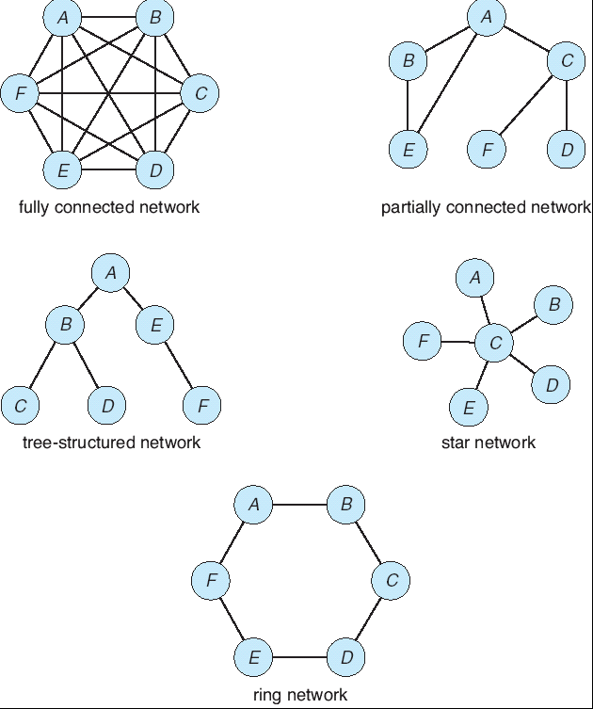
Network Topology

Slide 16
Communication Structure
The design of a communication network must address four basic
issues:
Naming and name resolution - How do two processes locate each other to communicate?
Routing strategies - How are messages sent through the network?
Connection strategies - How do two processes send a sequence of messages?
Contention - The network is a shared resource, so how do we resolve conflicting demands for its use?

Slide 17
Naming and Name Resolution
Name systems in the network
Address messages with the process-id
Identify processes on remote systems by
      <host-name, identifier> pair
Domain name service (DNS) – specifies the naming structure of the hosts, as well as name to address resolution (Internet)

Slide 18
Routing Strategies
Fixed routing - A path from A to B is specified in advance; path changes only if a hardware failure disables it
  Since the shortest path is usually chosen, communication costs are minimized
  Fixed routing cannot adapt to load changes
  Ensures that messages will be delivered in the order in which they were sent
Virtual circuit - A path from A to B is fixed for the duration of one session. Different sessions involving messages from A to B may have different paths
  Partial remedy to adapting to load changes
  Ensures that messages will be delivered in the order in which they were sent

Slide 19
Routing Strategies (Cont.)
Dynamic routing - The path used to send a message form site A to site B is chosen only when a message is sent
  Usually a site sends a message to another site on the link least used at that particular time
  Adapts to load changes by avoiding routing messages on heavily used path
  Messages may arrive out of order
    This problem can be remedied by appending a sequence number to each message

Slide 20
Connection Strategies
Circuit switching - A permanent physical link is established for the duration of the communication (i.e., telephone system)
Message switching - A temporary link is established for the duration of one message transfer (i.e., post-office mailing system)
Packet switching - Messages of variable length are divided into fixed-length packets which are sent to the destination
  Each packet may take a different path through the network
  The packets must be reassembled into messages as they arrive
Circuit switching requires setup time, but incurs less overhead for shipping each message, and may waste network bandwidth
  Message and packet switching require less setup time, but incur more overhead per message

Slide 21
Contention
Several sites may want to transmit information over a link
simultaneously. Techniques to avoid repeated collisions include:
CSMA/CD - Carrier sense with multiple access (CSMA); collision detection (CD)
  A site determines whether another message is currently being transmitted over that link. If two or more sites begin transmitting at exactly the same time, then they will register a CD and will stop transmitting
  When the system is very busy, many collisions may occur, and thus performance may be degraded
CSMA/CD is used successfully in the Ethernet system, the most common network system

Slide 22
Contention (Cont.)
Token passing - A unique message type, known as a token, continuously circulates in the system (usually a ring structure)
  A site that wants to transmit information must wait until the token arrives
  When the site completes its round of message passing, it retransmits the token
  A token-passing scheme is used by some IBM and HP/Apollo systems
Message slots - A number of fixed-length message slots continuously circulate in the system (usually a ring structure)
  Since a slot can contain only fixed-sized messages, a single logical message may have to be broken down into a number of smaller packets, each of which is sent in a separate slot
  This scheme has been adopted in the experimental Cambridge Digital Communication Ring

Slide 23
Communication Protocol
The communication network is partitioned into the following
multiple layers:
Physical layer – handles the mechanical and electrical details of the physical transmission of a bit stream
Data-link layer – handles the frames, or fixed-length parts of packets, including any error detection and recovery that occurred in the physical layer
Network layer – provides connections and routes packets in the communication network, including handling the address of outgoing packets, decoding the address of incoming packets, and maintaining routing information for proper response to changing load levels

Slide 24
Communication Protocol (Cont.)
Transport layer – responsible for low-level network access and for message transfer between clients, including partitioning messages into packets, maintaining packet order, controlling flow, and generating physical addresses
Session layer – implements sessions, or process-to-process communications protocols
Presentation layer – resolves the differences in formats among the various sites in the network, including character conversions, and half duplex/full duplex (echoing)
Application layer – interacts directly with the users’ deals with file transfer, remote-login protocols and electronic mail, as well as schemas for distributed databases

Slide 25
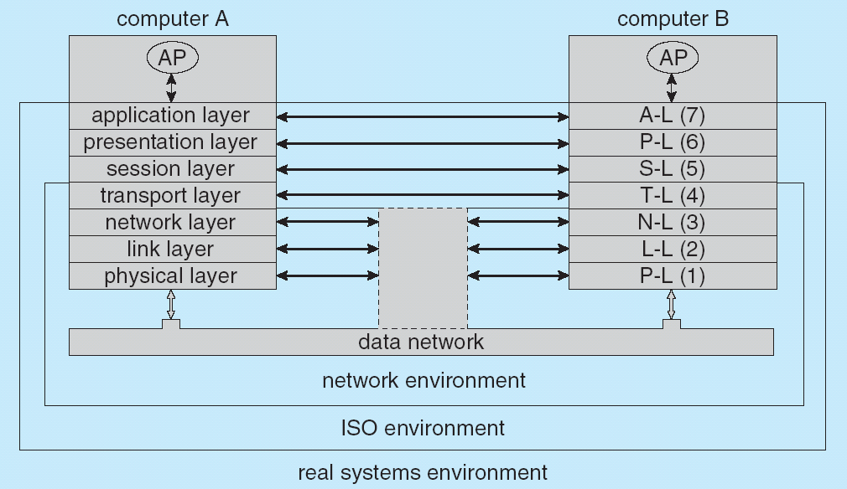
Communication Via ISO Network Model

Slide 26
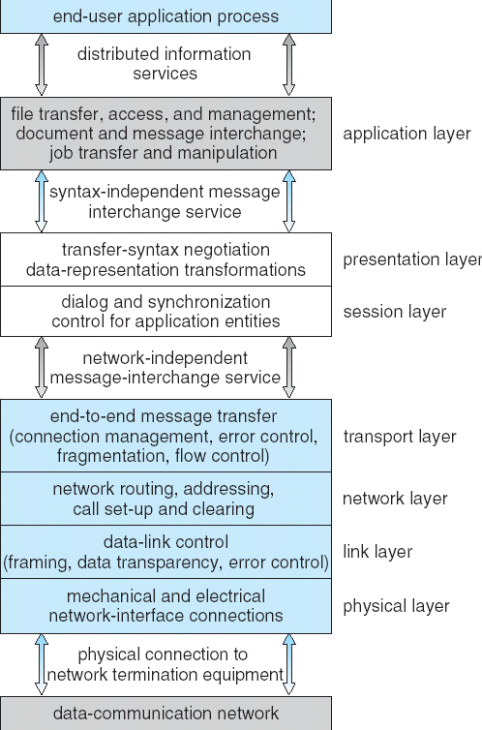
The ISO Protocol Layer

Slide 27
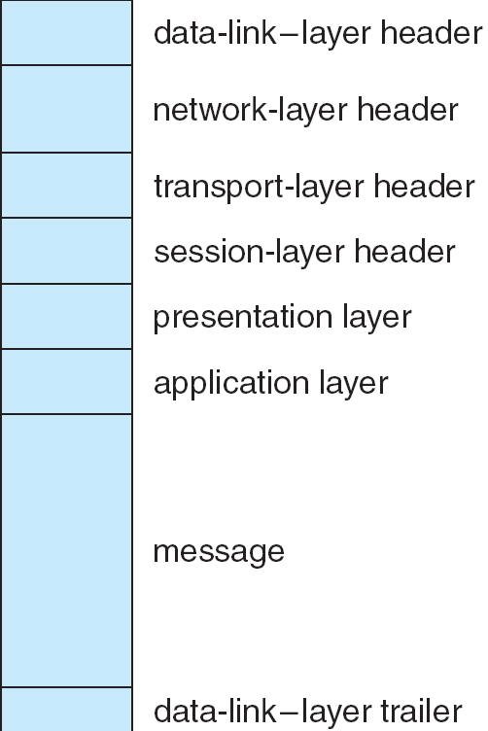
The ISO Network Message

Slide 28
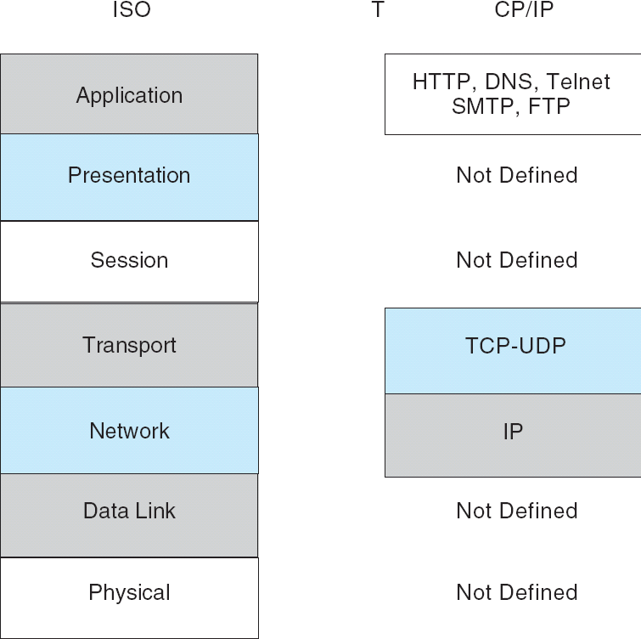
The TCP/IP Protocol Layers

Slide 29
Robustness
Failure detection
Reconfiguration

Slide 30
Failure Detection
Detecting hardware failure is difficult
To detect a link failure, a handshaking protocol can be used
Assume Site A and Site B have established a link
  At fixed intervals, each site will exchange an I-am-up message indicating that they are up and running
If Site A does not receive a message within the fixed interval, it assumes either (a) the other site is not up or (b) the message was lost
Site A can now send an Are-you-up? message to Site B
If Site A does not receive a reply, it can repeat the message or try an alternate route to Site B

Slide 31
Failure Detection (cont)
If Site A does not ultimately receive a reply from Site B, it concludes some type of failure has occurred
Types of failures:
- Site B is down
- The direct link between A and B is down
- The alternate link from A to B is down
- The message has been lost
However, Site A cannot determine exactly why the failure has occurred

Slide 32
Reconfiguration
When Site A determines a failure has occurred, it must reconfigure the system:
1. If the link from A to B has failed, this must be broadcast to every site in the system
2. If a site has failed, every other site must also be notified indicating that the services offered by the failed site are no longer available
When the link or the site becomes available again, this information must again be broadcast to all other sites

Slide 33
Design Issues
Transparency – the distributed system should appear as a conventional, centralized system to the user
Fault tolerance – the distributed system should continue to function in the face of failure
Scalability – as demands increase, the system should easily accept the addition of new resources to accommodate the increased demand
Clusters – a collection of semi-autonomous machines that acts as a single system

Slide 34
Example: Networking
The transmission of a network packet between hosts on an Ethernet network
Every host has a unique IP address and a corresponding Ethernet (MAC) address
Communication requires both addresses
Domain Name Service (DNS) can be used to acquire IP addresses
Address Resolution Protocol (ARP) is used to map MAC addresses to IP addresses
If the hosts are on the same network, ARP can be used
  If the hosts are on different networks, the sending host will send the packet to a router which routes the packet to the destination network

Slide 35
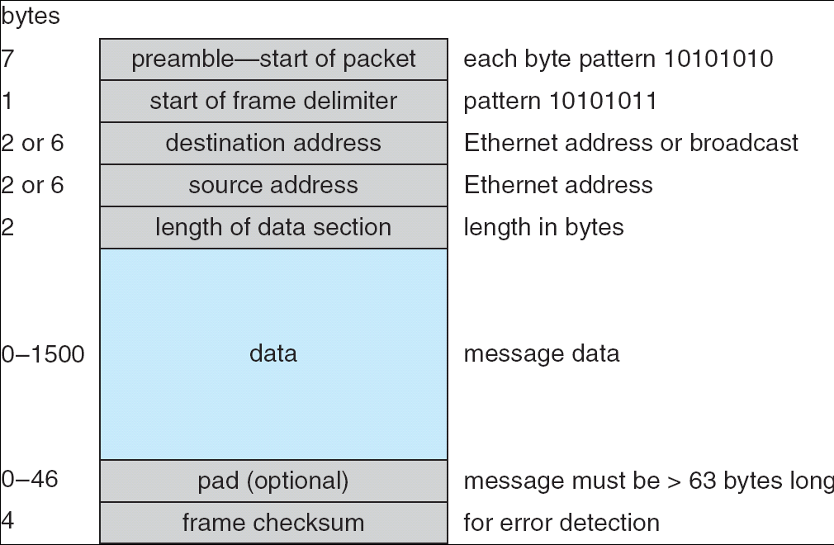
An Ethernet Packet

Slide 36
End of Chapter 16

